Slide 1
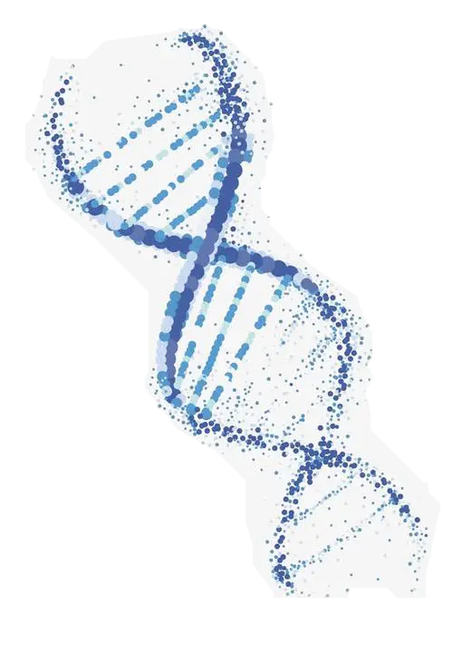
Predicting the abundance of TYR genes in bacteria based on Metagenomics and Machine Learning
Mingji Zhang
2023.06.16

Slide 2
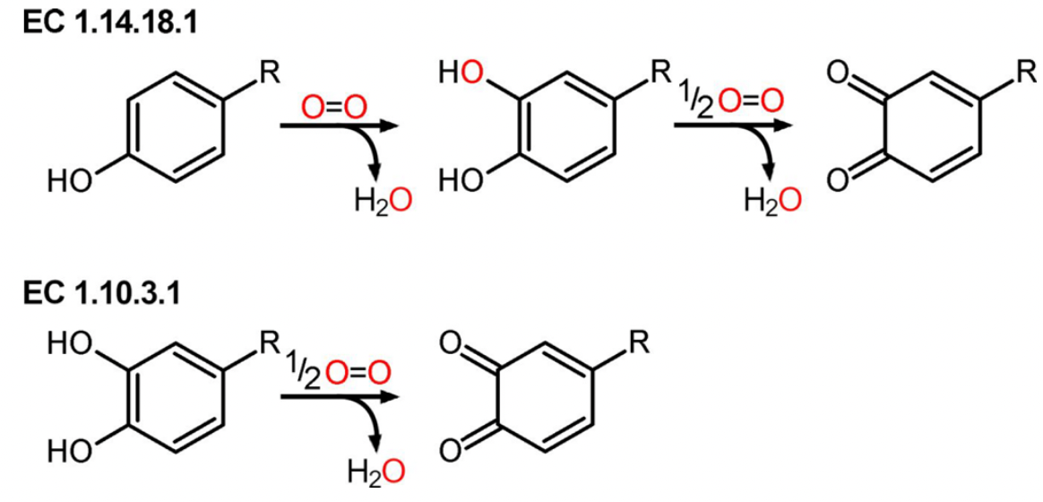
Predicting the abundance of TYR genes in bacteria based on Metagenomics and Machine Learning .
Tyrosinase（TYR）
One of the ways in which organic carbon accumulates in the land is achieved by phenolic compounds, which inhibit the degradation of soil organic matter by inhibiting the activity of organic matter degrading enzymes. Historically, the enzymatic removal of phenolic compounds by bacterial tyrosinase has been hindered by anoxic conditions in soils due to flooding. Bacterial tyrosinases are a subgroup of oxidoreductases that oxidatively remove phenolic compounds and reduce molecular oxygen to water. ^{[1]}
Figure 1. Reactions catalyzed by TYRs. Monophenols (EC1.14.18.1) and o-diphenols (EC1.10.3.1) are converted into reactive quinones by reducing molecular oxygen to water.^{[2]}
[1] Pretzler, M.;Rompel, A.What Causes theDifferent Functionality inType-III-Copper Enzymes? AStateoftheArt Perspective. Inorg. Chim. Acta 2018, 481,25−31.
[2] Bairoch, A.TheENZYME Database in2000. Nucleic Acids Res. 2000, 28,304−305.

Slide 3
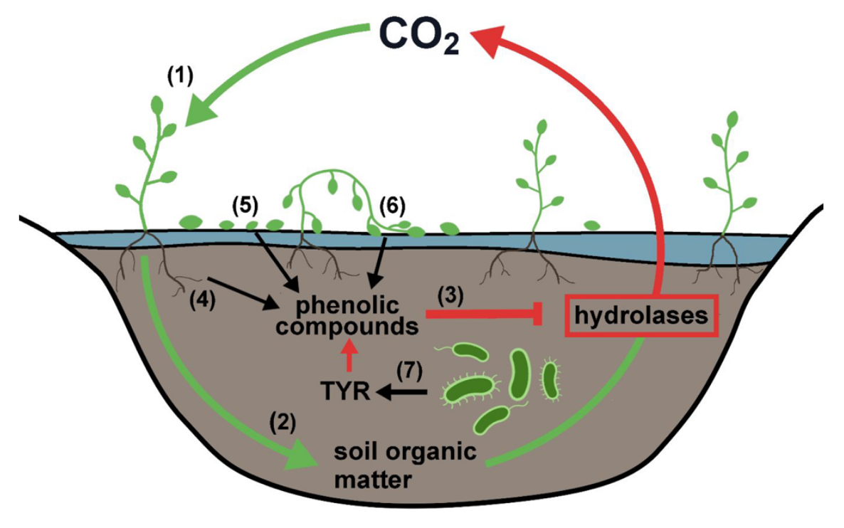
Predicting the abundance of TYR genes in bacteria based on Metagenomics and Machine Learning .
Current Situation & Why TYR
In recent years, with global climate change, anoxic conditions in soils have been threatened by reduced rainfall and persistent summer droughts.
This may allow tyrosinase to reduce the concentration of phenolic compounds, which in turn increases the release of stored carbon back into the atmosphere.^{[1]}
In the last two decades, rapid developments in the field of whole genome sequencing and bioinformatics have led to an overabundance of fully sequenced bacterial genomes and allowed one to efficiently annotate protein functions of uncharacterized proteins based on their amino acid sequences. However, there are still substantial gaps in the identification of TYR bacteria (i.e. containing TYR functional genes), confined within soil systems.
Figure 2. TYRs, produced by bacteria indigenous to soil, are capable of reducing the concentration of phenolic compounds, and thus enable the degradation of soil organic matter.
[1] Panis, F., & Rompel, A. (2022). The Novel Role of Tyrosinase Enzymes in the Storage of Globally Significant Amounts of Carbon in Wetland Ecosystems. Environmental Science & Technology, 56(17), 11952-11968.

Slide 4
Predicting the abundance of TYR genes in bacteria based on Metagenomics and Machine Learning .
Aims
TYR gene and bacterial species matrix obtained by analyzing multiple sets of public Metagenomics library data（NCBI）
Comparison of genomic data with known sequenced TYR gene short sequences to obtain TYR gene abundance
Potential identification of bacterial hosts for TYR genes by machine learning methods

Slide 5
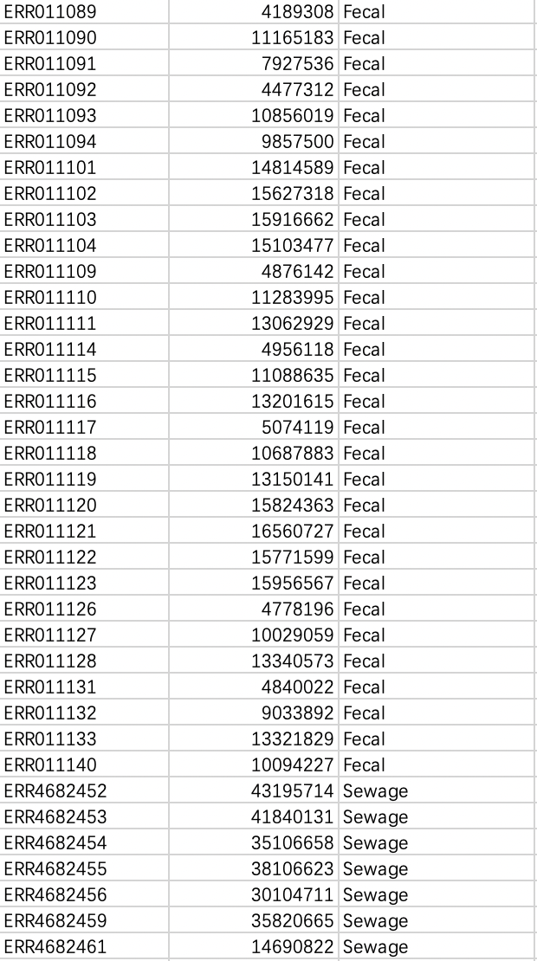
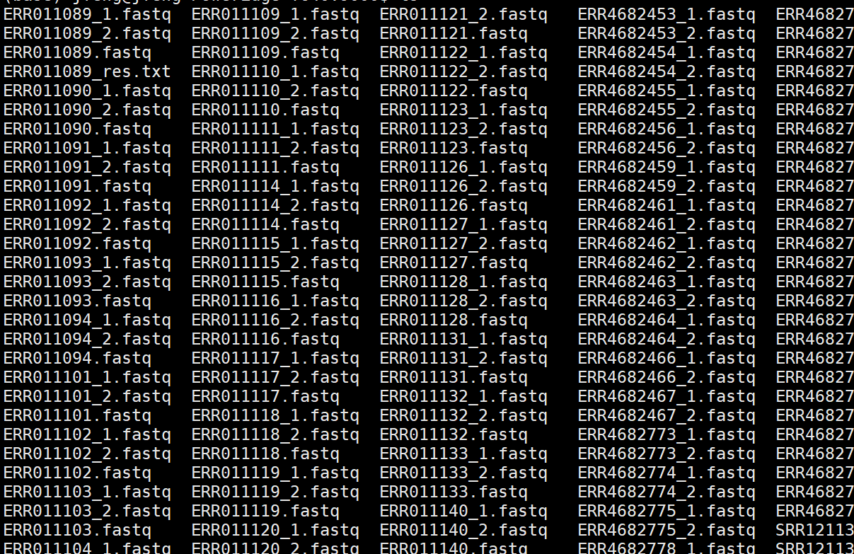
Predicting the abundance of TYR genes in bacteria based on Metagenomics and Machine Learning .
TYR gene and bacterial species matrix
130 datasets
4 kinds of environment
Fecal
Sewage
Large River
Urban River
Data size: 1TB

Slide 6
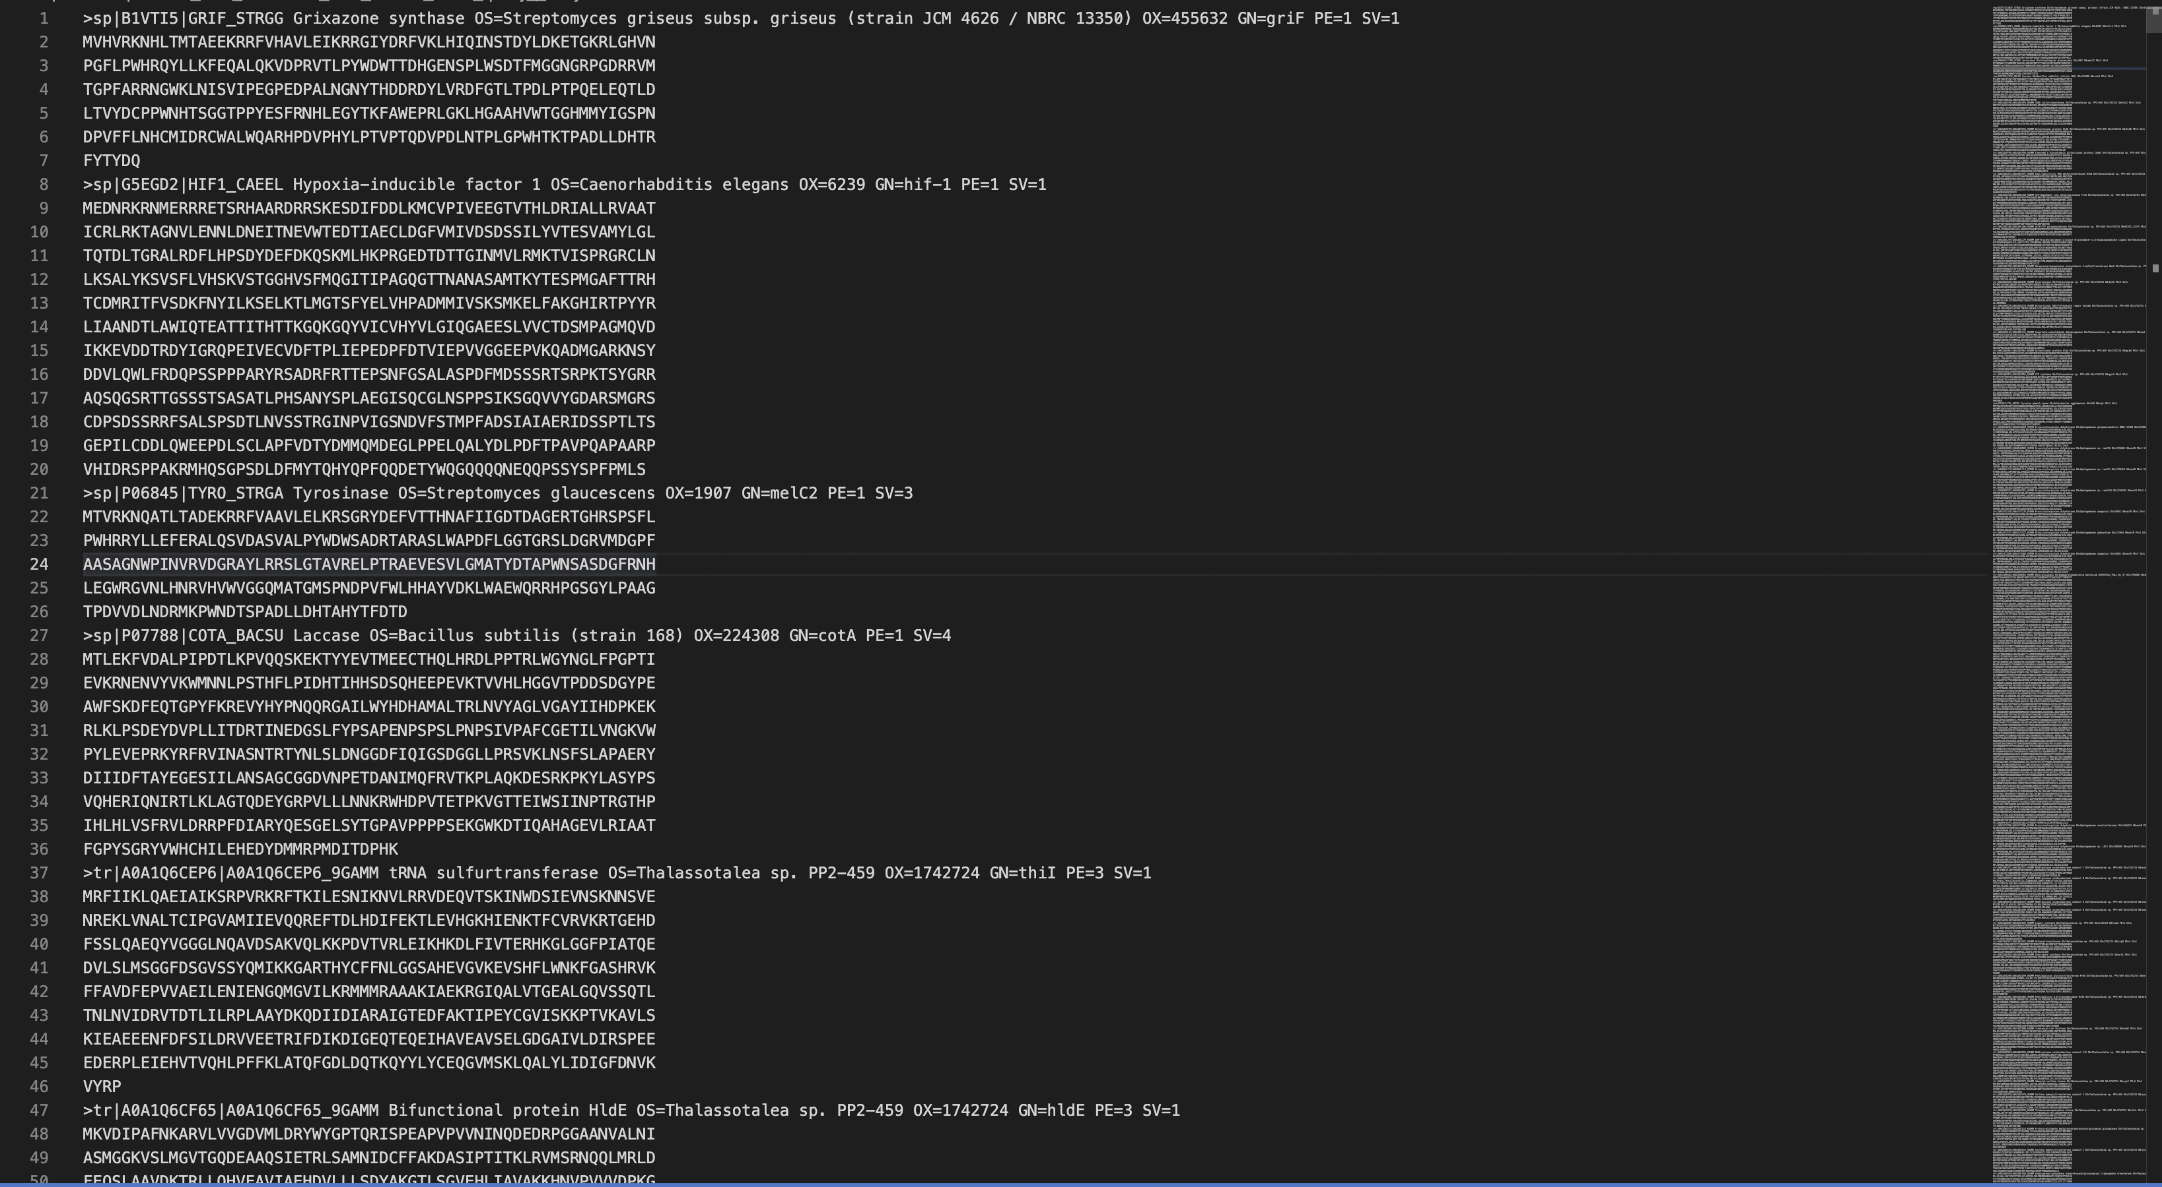
Predicting the abundance of TYR genes in bacteria based on Metagenomics and Machine Learning .
TYR gene and bacterial species matrix

Slide 7
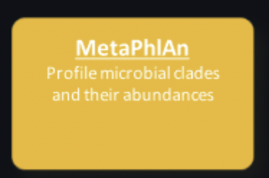
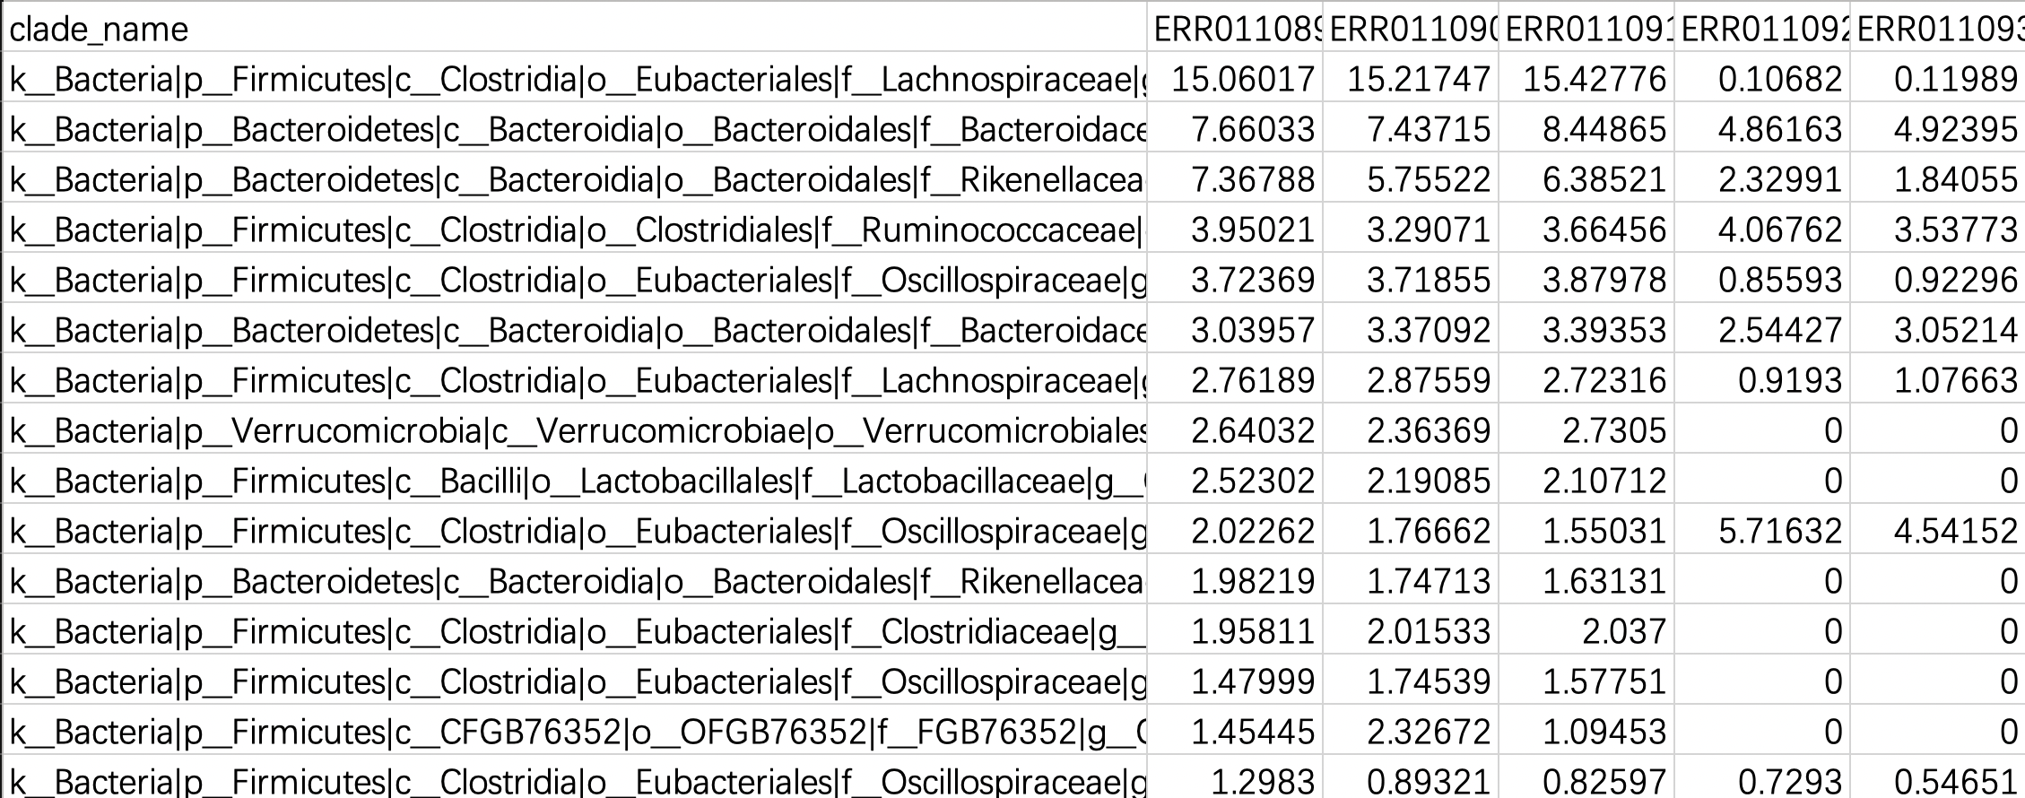
Predicting the abundance of TYR genes in bacteria based on Metagenomics and Machine Learning .
TYR gene and bacterial species matrix

Slide 8
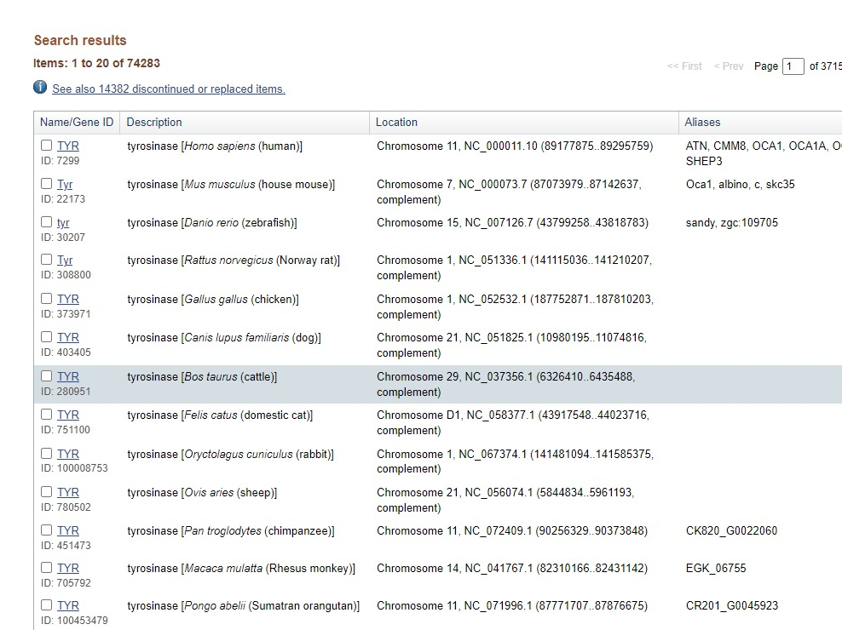
Predicting the abundance of TYR genes in bacteria based on Metagenomics and Machine Learning .
To obtain TYR gene abundance

Slide 9
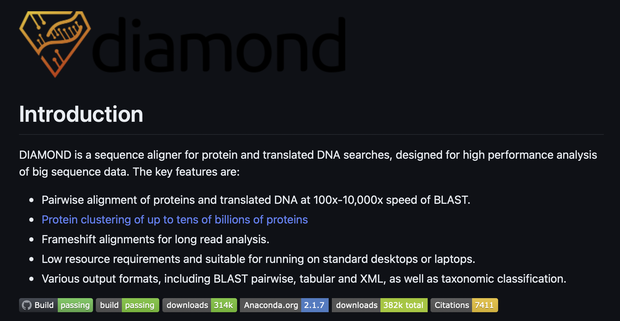
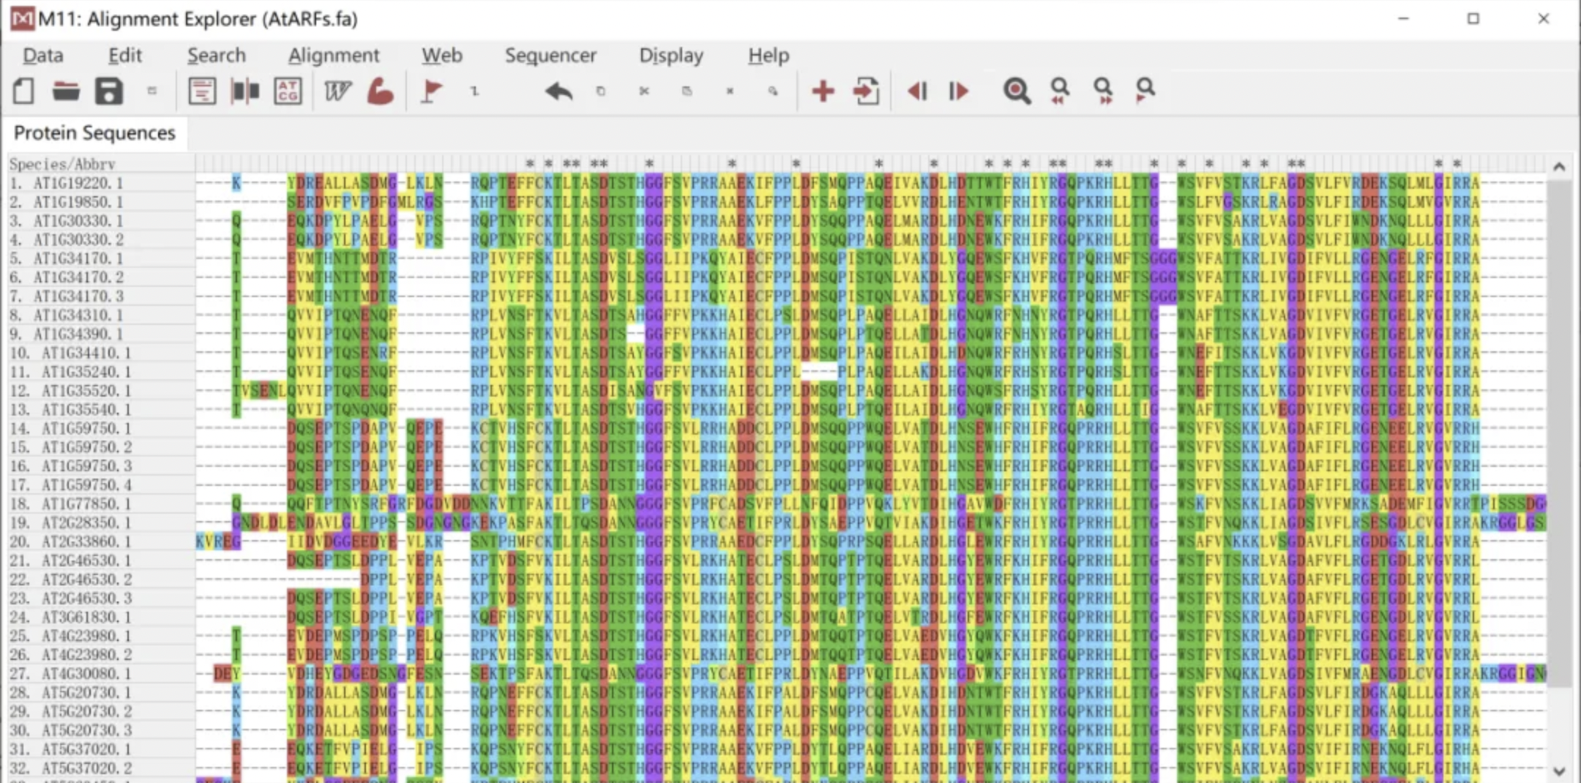
Predicting the abundance of TYR genes in bacteria based on Metagenomics and Machine Learning .
To obtain TYR gene abundance

Slide 10
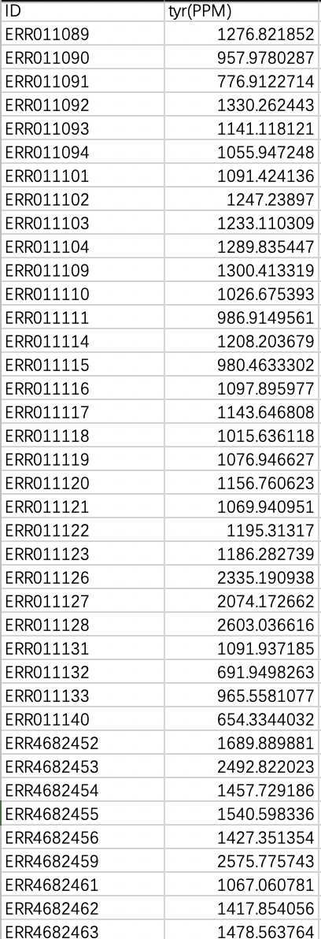
Predicting the abundance of TYR genes in bacteria based on Metagenomics and Machine Learning .
To obtain TYR gene abundance
The abundance of TYRs was reported in the unit of “ppm”（i.e., one TYR-like read in one million metagenomic sequencing reads) ^{[1]}
[1] Yang, Y., Li, B., Ju, F., Zhang, T., 2013. Exploring variation of antibiotic resistance genes in activated sludge over a four-year period through a metagenomic approach. Environ. Sci. Technol. 47 (18), 10197–10205.

Slide 11
Predicting the abundance of TYR genes in bacteria based on Metagenomics and Machine Learning .
Continuing……
Potential identification of bacterial hosts for TYR genes by machine learning methods

Slide 12
Predicting the abundance of TYR genes in bacteria based on Metagenomics and Machine Learning .
Potential identification of bacterial hosts for TYR genes by machine learning methods
Bioinformatics
Machine Learning
Results
Metagenomic Data
Linear regression
80%
Training datasets
Validation
Compared predict and observed abundance
Explanatory Variables
Responses
Abundant genera
Alpha & Beta
Diversity analysis
Family & Genus
TYRs Matrix
Testing datasets
20%
Abundance value
network diagram
Built up

Slide 13
Predicting the abundance of TYR genes in bacteria based on Metagenomics and Machine Learning .
Potential identification of bacterial hosts for TYR genes by machine learning methods
Bioinformatics
Machine Learning
Metagenomic Data
Results
80%
Training datasets
Validation
Explanatory Variables
Responses
Working on
Continuing
DOWN
1. Abundant genera
2. Genus & Species
TYRs Matrix
Testing datasets
20%
3. Abundance value

Slide 14
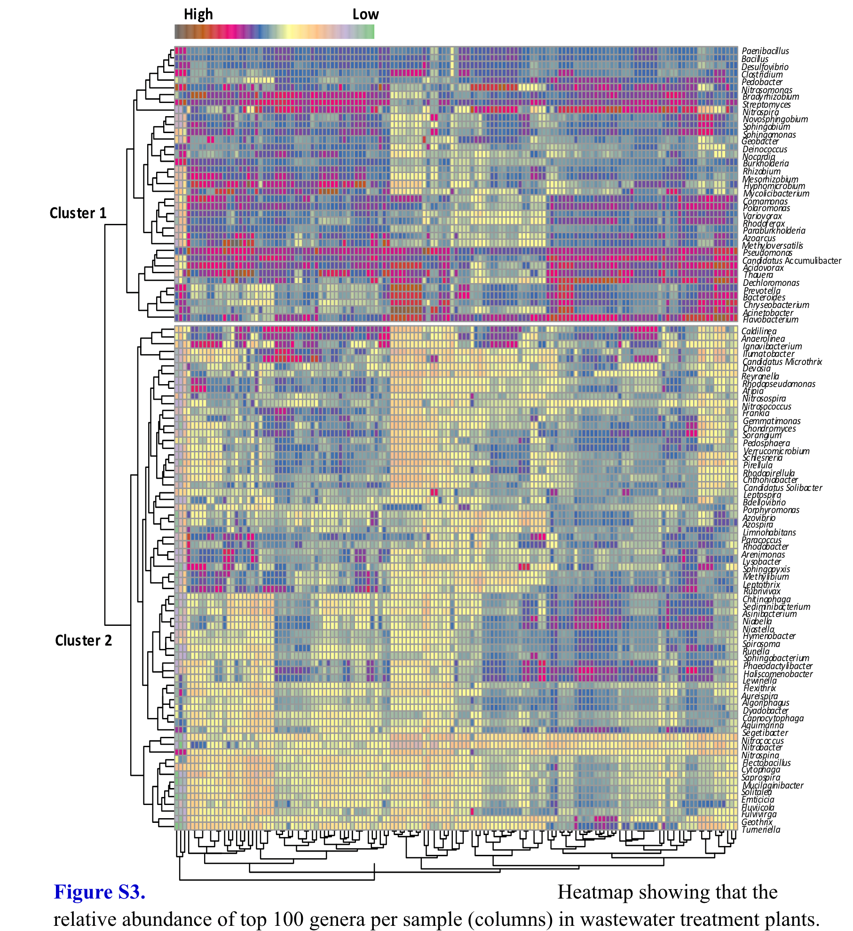
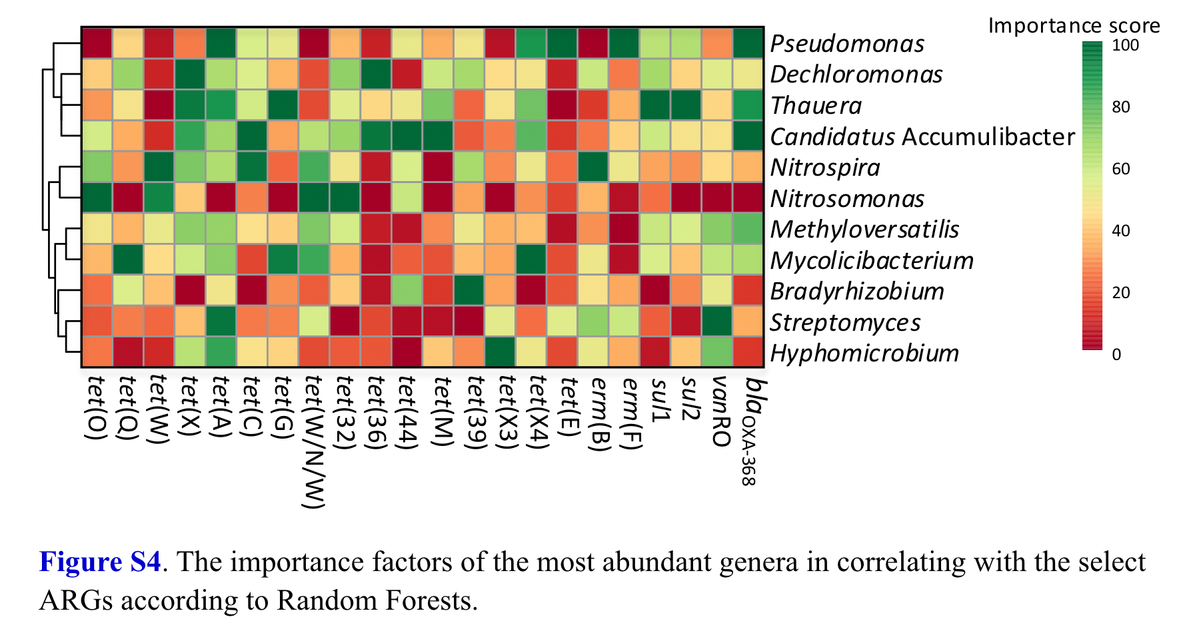
Predicting the abundance of TYR genes in bacteria based on Metagenomics and Machine Learning .

Slide 15
Predicting the abundance of TYR genes in bacteria based on Metagenomics and Machine Learning .
References
Bairoch, A.TheENZYME Database in2000. Nucleic Acids Res. 2000, 28,304−305.
Panis, F., & Rompel, A. (2022). The Novel Role of Tyrosinase Enzymes in the Storage of Globally Significant Amounts of Carbon in Wetland Ecosystems. Environmental Science & Technology, 56(17), 11952-11968.
Pretzler, M.;Rompel, A.What Causes theDifferent Functionality inType-III-Copper Enzymes? AStateoftheArt Perspective. Inorg. Chim. Acta 2018, 481,25−31.
Yang, Y., Li, B., Ju, F., Zhang, T., 2013. Exploring variation of antibiotic resistance genes in activated sludge over a four-year period through a metagenomic approach. Environ. Sci. Technol. 47 (18), 10197–10205.

